Slide 1

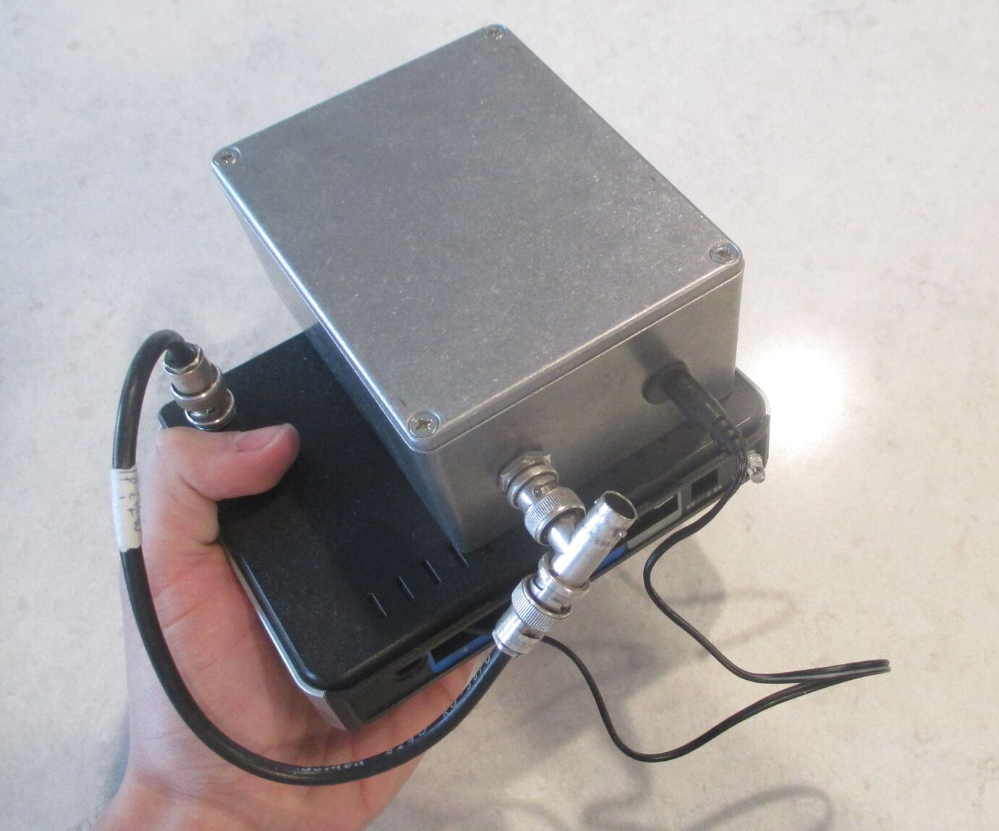
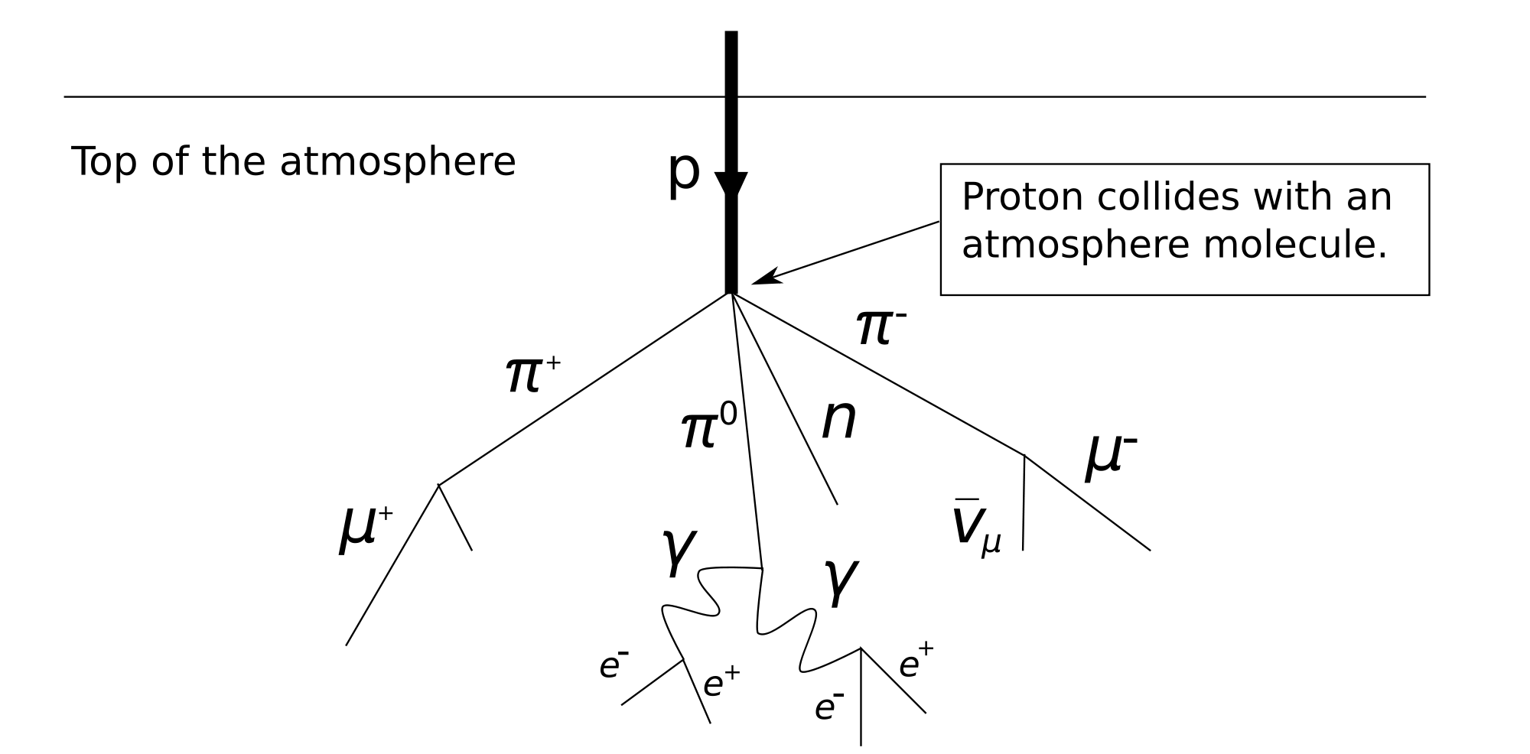
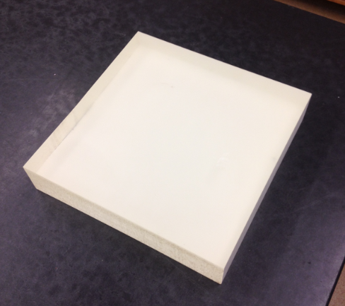
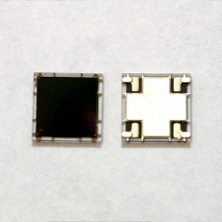
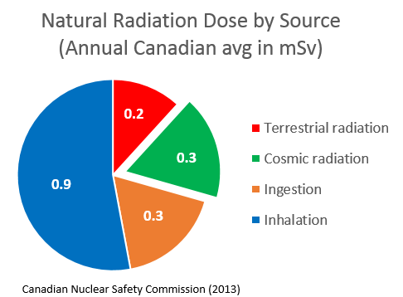
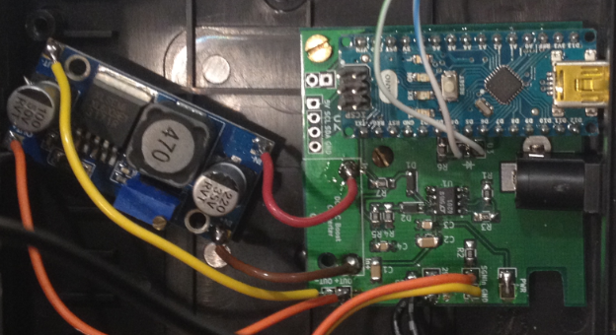
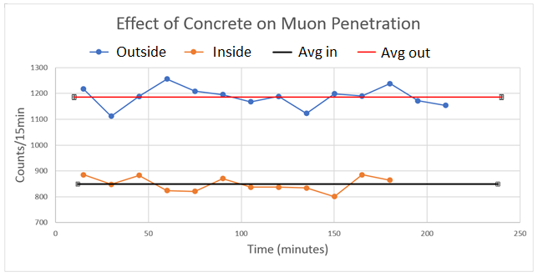
Instruments for Natural Radiation Detection:
Educating the public using inexpensive muon detectors
J. Hanania and J.M.K.C. Donev
Overview
How Muons are Detected
Constructed two muon detectors for use as educational tools
Cosmic muons bombard Earth’s surface from space, contributing to natural radiation doses
Scintillation: Muon produces photons
Plastic scintillator
Small and lightweight
Low operating voltage (5V)
Cost per unit
~ $400CAD
Top of troposphere
Muon
Photons
μ
Muon
Figure 2. Showers of cosmic particles occur ~15 km above sea level
Light detection: Photons produce electrical signal
The average Canadian receives around 20% of their natural radiation dose from cosmic rays, which include muons.
Due to ionizing properties, muons can be detected easily.
Silicon photomultiplier
Electrical signal
Photons
V
Capabilities:
Figure 1. Muon detectors were built from scratch, shown to be about the size of a hand.
6 mm
Record time of muon event
Distinguish between high and low energy muons
Generate histogram of count rates and energies
t
Signal processing: Circuitry amplifies and extends signal so it can be measured by a computer
Figure 3. Natural radiation dose by source received by the average Canadian per year.
# of detectors | 1 | 100
Cost per detector (CAD) | $392 | $126
Circuitry
V
Table 1. Cost per detector unit; values are approximate as shipping costs may vary and fewer/extra components may be needed
t
Conclusion
Educational uses
These portable muon detectors can operate just about anywhere, requiring only a laptop connection. Various experiments can be performed, with many educational opportunities in particle physics, nuclear physics, and special relativity. Moreover, these detectors can be reproduced by a dedicated undergraduate student or teacher at low cost.
Many possible educational uses, including:
Shielding experiment: Determined that ~0.9 m of concrete is above UCalgary Physics basement
Passive demonstration: gives observer knowledge of and appreciation for the presence of muons
Experimentation:
Special Relativity test
Muon shielding from various materials
High elevation tests
Instrument construction: valuable experience gained in the building of such an instrument
Canada-wide muon project: educators from around Canada build their own instruments on their own or with a class
Figure 3. Muon count rates taken inside and outside UofC physics basement determined presence of concrete (estimated using data from [Ref 2]).
References
United Nations Scientific Committee on the Effects of Atomic Radiation (2008). “Sources and effects of ionizing radiation”, UNSCEAR 2008 Report. New York: United Nations (published 2010).
E. Aguayo et al., “Cosmic Ray Interactions in Shielding Materials", United States Department of Energy, prepared by Pacific Northwest National Labs, 2011
S. Axani, J. Conrad, and C. Kirby, “The Desktop Muon Detector: A simple, physics-motivated machine- and electronics-shop project for university students”. Massachusetts Institute of Technology (2016).
Easily repeated using other materials like wood, aluminum, or lead.
We would like to thank the Canadian Nuclear Society for the funding of this project.

